Slide 1
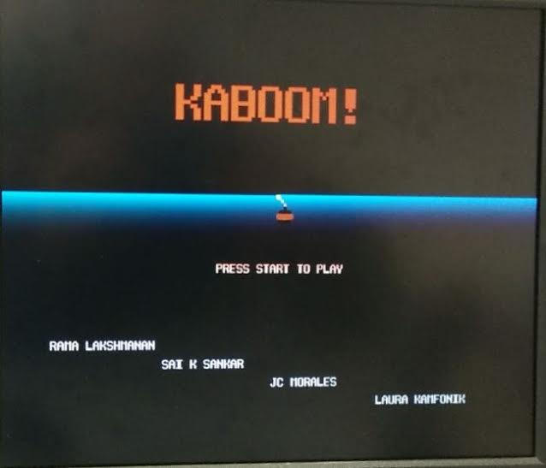
Notes:
Sai

Slide 2
Why did we do this??
Kaboom is one of Atari’s most popular and successful games.
We have made an attempt to resurrect this popular game, with few changes.
Gives everyone a chance to revisit their childhood days, revive memories of all the wonderful arcade games of the 90’s!
Implementing an arcade game like Kaboom on an FPGA gives the advantage of portability.
Something to unwind with, after a tiring day :)
Notes:
Sai

Slide 3
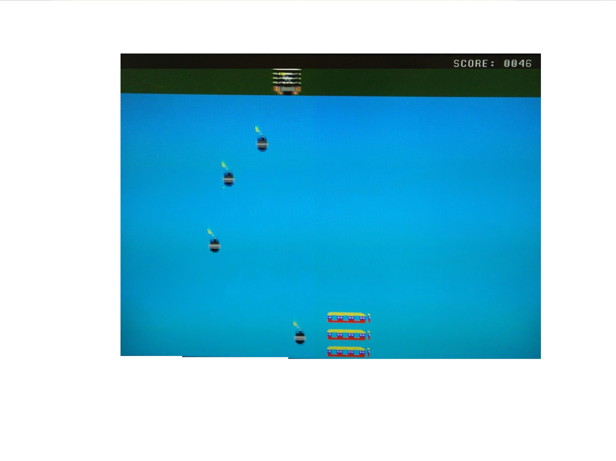
How it works….
VGA is the heart of our project.
On programming the FPGA, the title screen appears on the monitor, with a “Press Start to Play” message, and our names.
On doing so, which here means activating a switch on the Nexys-3 board, or pushing a button on the JAMMA interface, we enter into the game mode.
The game involves moving the bomber continuously from left to right and back; same with the pad at the bottom.
These movements are achieved via the buttons on the Nexys-3 board.
Score increments each time a bomb is caught. The score is displayed on the screen in decimal form, and on the 7-segment display in hex form.
Notes:
Sai

Slide 4
What else???
Pause and Resume function.
“Game Over” and “You Win” Screens.
Sound Effects and Bluetooth Game Controller.
Also replaced the happy bomber sprites with and without bomb with the ones which are more lively and energetic in throwing bombs...
Notes:
Sai

Slide 5
Graphics Implementation
Almost all graphics were designed from scratch.
We used the 576KB BRAM available on board to fit them into the design.
Graphics were re-dimensioned in order to meet size constraints. And background is dynamically generated in order to save memory.
We built a C# application to convert each sprite into a COE file in order to initialize the BRAM.
We treat each sprite as a “block” and we fetch the image pixel by pixel into the FPGA. Then we are able to move the “block” at our will. It is also useful to check for collisions.
Notes:
Juan

Slide 6




The Sprites
The Happy Bomber
Bombs
Pads
Explosion
Background
Notes:
Juan

Slide 7
Our requirements for this project
Digilent Nexys3 Spartan-6 FPGA board
VGA module, BRAM capabilities, Buttons/Switches, 7-segment display, PMOD ports, PMOD AMP2 module, UART port
VGA display
JAMMA Interface
Bluetooth module
Xilinx ISE Design Suite
IP Core tools
Notes:
Juan

Slide 8
What did our design do
The principal objective of our design was to emulate Kaboom on an FPGA.
The FPGA had to be capable of performing 90%, to nearly all the functions available in the original version.
All the graphic features, like detection of bombs by the pads, have been implemented purely through calculations of the horizontal and vertical coordinates of the VGA display.
The VGA module reads the information stored at BRAM and draws the sprites on the display, in positions specified by appropriate x and y coordinates.
Notes:
Juan

Slide 9
Title Slide & Text implementation
The title slide, while graphically simple, has a powerful underlying mechanism: a scalable Font ROM.
Character tiles are read from a ROM module.
A variable scale factor allows the same tile to draw different size text.
Pixel boundaries of each tile are at a dynamically scaled offset from a center point, allowing text to grow or shrink.
The reference position can also be altered, allowing text to move.
Current Implementations: Title Page, Scoreboard, Game Over, You Win
Planned Enhancements:
Pause
Missed Bomb Count
dynamically appearing text that “types” itself across the title screen
Notes:
Laura

Slide 10
Scalable Font ROM
Custom 8 bit x 16 bit tiles
6-bit address space allows up to 64 different characters
We have created tiles for 0-9, A-Z, !, :, and a blank space
Q: Why do it this way?
A: It saves our boss money!
Easy to copy the Font ROM and its scaling algorithm to new games
Easy to add more text if the game is improved / features added
Extra labor up front = cost savings in the future!
Notes:
Laura

Slide 11
Font ROM example
{
8'b00000000, // 0
8'b00000000, // 1
8'b00010000, // 2 *
8'b00111000, // 3 ***
8'b01101100, // 4 ** **
8'b11000110, // 5 ** **
8'b11000110, // 6 ** **
8'b11111110, // 7 *******
8'b11000110, // 8 ** **
8'b11000110, // 9 ** **
8'b11000110, // a ** **
8'b11000110, // b ** **
8'b00000000, // c
8'b00000000, // d
8'b00000000, // e
8'b00000000 // f
}
The “A” to the left (and in our code) was adapted from a VHDL example at the link below.
All other characters were designed by hand to fit the same tile size and the game aesthetics.
Space above and below the character allows the line spacing to scale with the tile size.
“A” source: http://ece320web.groups.et.byu.net/labs/VGATextGeneration/VGA_Terminal.html
Notes:
Laura

Slide 12
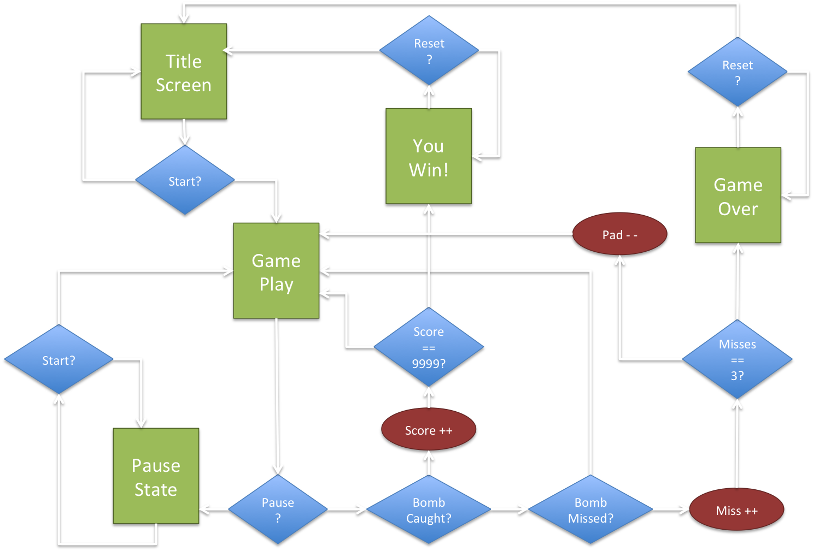
D
I
A
G
R
A
M
B
L
O
C
K
Notes:
Laura

Slide 13
Sprite Timeline
Initial milestone: to have the bomber and pads moving in a continuous horizontal manner on the screen.
Have a bomb to fall vertically, run in an endless loop.
One bomber could be seen at a time on the screen, by commenting out the other. Similarly, the the pads could also be independently commented out.
Background created later via an if-else block.
Basics accomplished, now the code was modified to have pads, bomber(s) and bombs move according to user input.
Sprites move either left or right on button presses, and stay still otherwise.
Notes:
Rama

Slide 14
Verilog Code
if (pad_r & pad_hi < 640) begin
pad_lo <= pad_lo + 3'b001;
pad_hi <= pad_hi + 3'b001;
end
else if(pad_l & pad_lo>1)
begin
pad_lo <= pad_lo - 3'b001;
pad_hi <= pad_hi - 3'b001;
end
else begin
pad_lo <=pad_lo; //0;
pad_hi <=pad_hi; //63;
end
if ((bomb_bot < 400) & (pad_hi>=bomb_lo&pad_hi<=bomb_lo+85)) begin //Bottom of the screen
x<=1;
bmb<=1;
bomb_top <= bomb_top + 3'b001;
bomb_bot <= bomb_bot + 3'b001;
Notes:
Rama

Slide 15
Verilog code (continued…)
rst_1<=0;
if(bomb_bot==140 | bomb_bot==172 |bomb_bot==205 | bomb_bot==237 | bomb_bot==270 |bomb_bot==302 |bomb_bot==334|bomb_bot==366)
begin
rst_1<=1;
end
else if ((bomb_bot == 399) & (pad_hi>=bomb_lo & pad_hi<=bomb_lo+85))
begin
score <= score + 1;
end
end

Slide 16
Still To Do…
Fix sprite sync issues
Sound Effects
Single Player Mode
Control bomber in pseudo-random pattern
Increment bomber speed
Extra: Bluetooth game controller
Notes:
Rama

Slide 17

Notes:
Rama

Slide 18
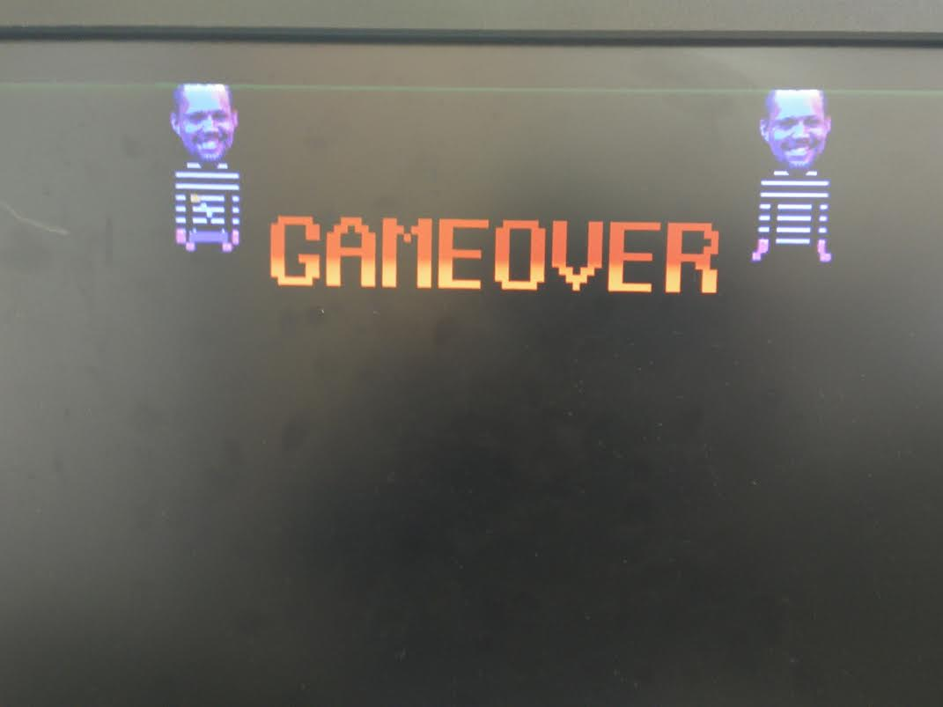

Slide 19
Questions?

